Slide 1

Online Payment Fraud Detection System
Fighting Transaction Fraud with machine Learning
10alytics Fullstack Data Science Final Project Cohort 3
Presented by : Olubolade Deborah Bunmi

Slide 2
Content
Introduction
Problem Statement
Methodology
Exploratory data
Feature engineering
Tools Used
Conclusion

Slide 3
Introduction
Blossom Bank also known as BB PLC is a multinational financial services group, that offers retail and investment banking, pension management, asset management and payments services, headquartered in London, UK.

Slide 4
Problem Statement
Customers are vulnerable to transaction fraud everyday. On this basis, the bank is in a dire need for a fraud detection model to help predict transaction crime. A constant reoccurrence of fraudulent incident will diminish the bank customer’s trust and affect the productivity of the bank. Hence, detecting and preventing fraud is important to the Bank.

Slide 5
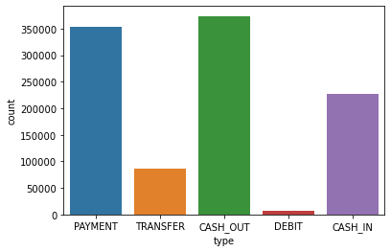
Exploratory Data Analysis (EDA)
This visualisation shows that users prefer the cash-out method of transaction to other channels of transaction. Payment transaction is the second most used transaction type

Slide 6
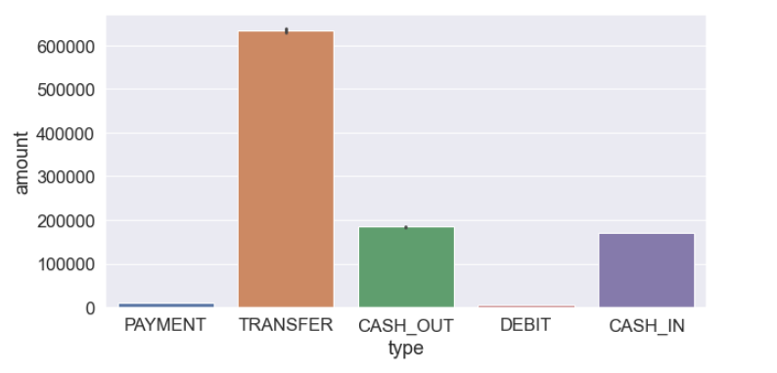
Although Cash out and Payment method are the most common type of transaction in this dataset, the chart indicates that Transfer transaction has the highest monetary value.

Slide 7
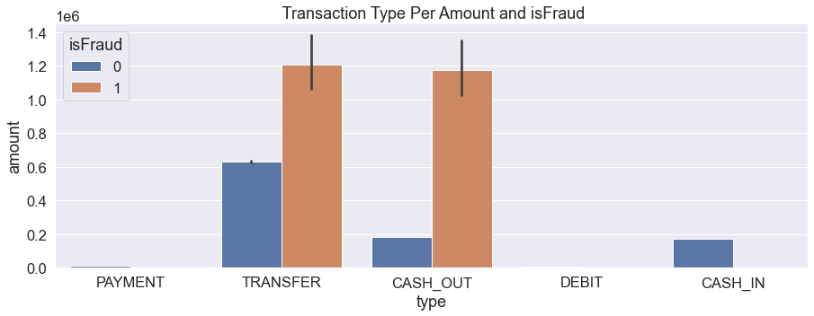
Transfer method of transaction is shown to record the highest number of fraudulent cases

Slide 8
Feature engineering
Two models were used in this project:
Logistics Regression
Decision Tree Classifier
This process is a technique that leverages data to create new variables
that are not in the training:

Slide 9
Accuracy Result
Logistics regression model
99.89962568247384% of the Transaction is Non-Fraud
0.10037431752616044% of the Transaction is Fraud
Decision Tree Classifier
100.0% of the Transaction is Non-Fraud
0.0% of the Transaction is Fraud

Slide 10
Conclusion
With this information, insight is gained into transaction services offered by the Bank using the proposed two models.
With this insight, the bank will develop solution to curb transaction crime , retain customers trust and effectively protect the bank’s values.

Slide 11
Tools used in this project
Anaconda
Jupyter Notebook
Python

Slide 12
Thank you !

